Slide 1
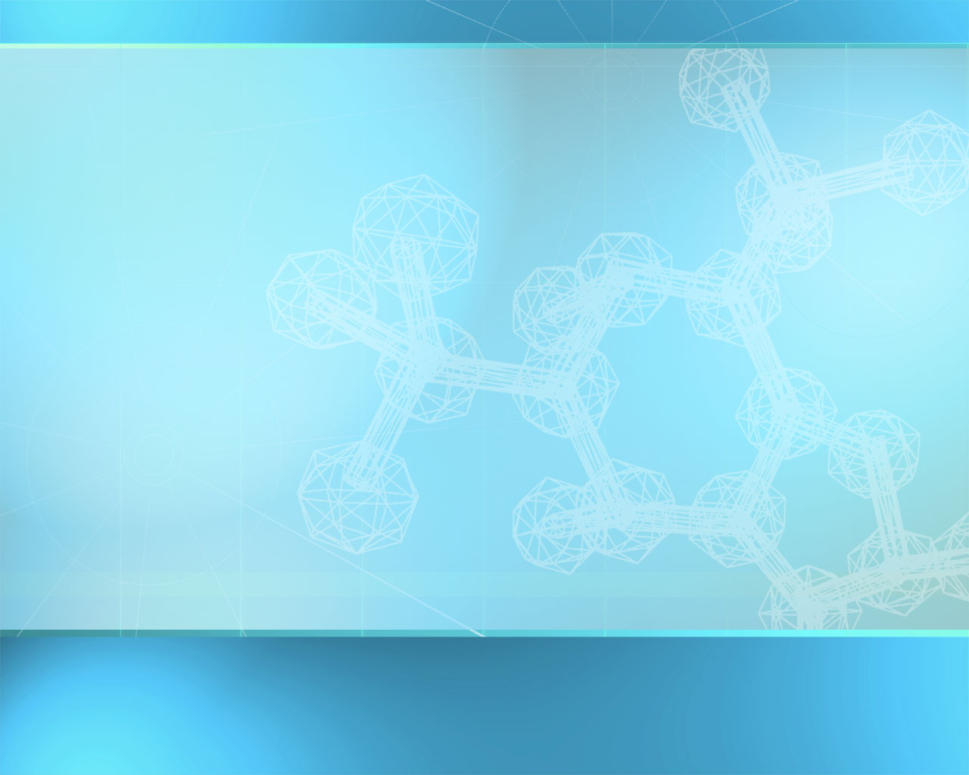
Proteins (Polypeptides)
Contain carbon, hydrogen, oxygen, nitrogen, and sulfur
Basic building block is the amino acid
There are 20 different kinds of amino acids
Amino acids are bonded together by peptide bonds (polypeptides).
Amino Acids (aa)
aa1
aa2
aa3
aa4
aa5
aa6
Peptide Bonds

Slide 2
Proteins (Polypeptides)
Six functions of proteins:
1. Storage : albumin (egg white)
2. Transport : hemoglobin
3. Regulatory : hormones
4. Movement : muscles
5. Structural : membranes, hair, nails
6. Enzymes : cellular reactions

Slide 3
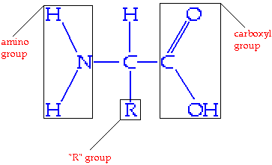
Proteins (Polypeptides)
Amino Acid
Amine group acts like a base, tends to be positive.
Carboxyl group acts like an acid, tends to be negative.
“R” group is variable, from 1 atom to 20.
Two amino acids join together to form a dipeptide.
Adjacent carboxyl and amino groups bond together.

Slide 4
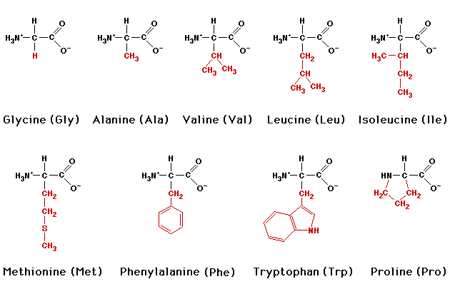
Some Amino Acids

Slide 5
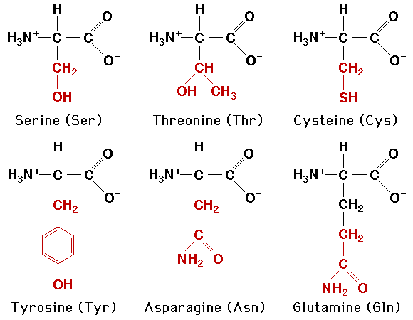
Some More Amino Acids

Slide 6
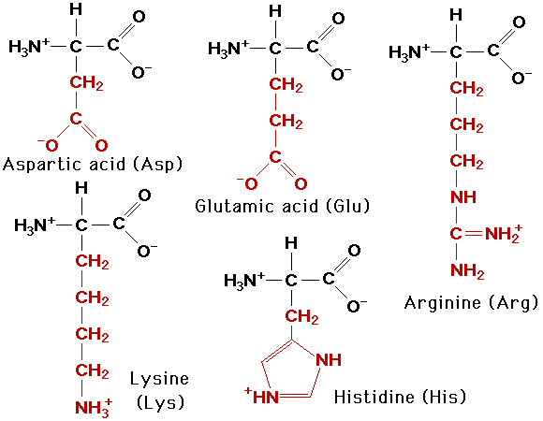
Still More Amino Acids

Slide 7
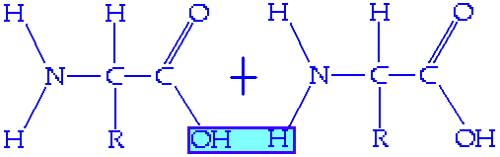

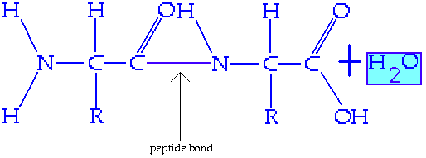
Formation of a Dipeptide
Dehydration synthesis

Slide 8
Proteins (Polypeptides)
Amino Acid + Amino Acid --> Dipeptide
Amino Acid + Dipeptide --> Tripeptide
A.A. + A.A. + …..+ Tripeptide --> Polypeptide

Slide 9
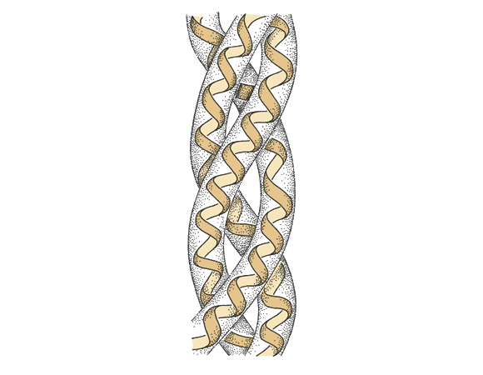
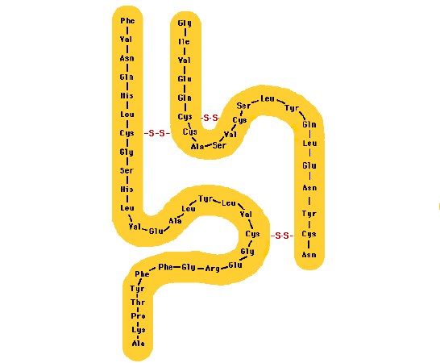
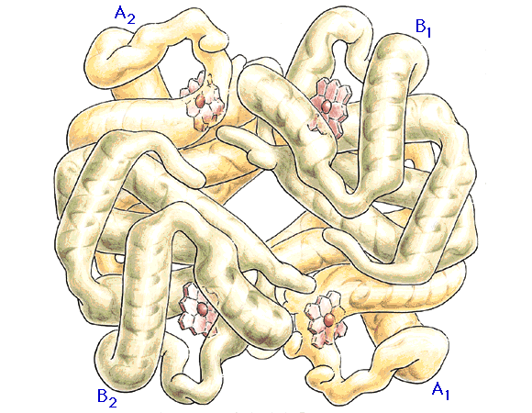
Proteins (Polypeptides)
A protein consists of one or more polypeptide chains.

Slide 10
Nucleic acids
DNA & RNA

Slide 11
What are Nucleic acids?
The fourth class of macromolecules composed of
carbon,hydrogen, oxygen, nitrogen, and phosphorus.
store and process an organism’s hereditary information.
The chemical link between generations
The source of genetic information in chromosomes
Simple units called nucleotides, connected in long chains
Nucleic acids are composed of long chains
of nucleotides linked by dehydration synthesis.

Slide 12
What do they do ?
Dictate amino-acid sequence in proteins
Give information to chromosomes, which is then passed from parent to offspring

Slide 13
What are they made of ?
Nucleotides have 3 parts:
1- phosphate group (P)
2- pentose sugar (5-carbon)
3- nitrogenous bases:
adenine (A)
thymine (T) DNA only
uracil (U) RNA only
cytosine (C)
guanine (G)
The P groups make the links that unite the sugars (hence a “sugar-phosphate backbone”

Slide 14
Nucleotide
Phosphate
Group
O
O=P-O
O
5
CH2
O
N
Nitrogenous base
(A, G, C, or T)
C⁴
C¹
Sugar
(deoxyribose)
C³
C²

Slide 15
Two types of Nucleotides (depending on the sugar they contain)
1- Ribonucleic acids (RNA)
The pentose sugar is Ribose (has a hydroxyl
group in the 3rd carbon---OH)
2- Deoxyribonucleic acids (DNA)
The pentose sugar is Deoxyribose (has just
an hydrogen in the same place--- H) Deoxy = “minus oxygen”

Slide 16
DNA Nucleotides
Composition (3 parts):
1- Deoxyribose sugar (no O in 3rd carbon)
2- Phosphate group
3- One of 4 types of bases (all containing nitrogen):
- Adenine
- Thymine (Only in DNA)
- Cytosine
- Guanine

Slide 17
DNA Nucleotides
DNA exists in the nucleus of our cells.
It contains the hereditary (genetic) information of the cell.
DNA encodes the information needed to build proteins, to regulate physiological processes, and to maintain homeostasis.
The genes that make each individual and each organism unique are carried as codes in the DNA

Slide 18
DNA Nucleotides
Composition (3 parts):
1- Deoxyribose sugar (no O in 3rd carbon)
2- Phosphate group
3- One of 4 types of bases (all containing nitrogen):
- Adenine
- Thymine (Only in DNA)
- Cytosine
- Guanine

Slide 19
How DNA is arranged?
Structural model:
Model proposed by Watson & Crick, 1953
DNA is a double-stranded molecule.
Two sugar-phosphate strands, next to each other, but running in opposite directions.
The phosphate end of one strand opposes the hydroxyl end of the other.
Specific Hydrogen bonds occur among bases from one chain to the other:
A---T , C---G
The two chains of DNA nucleotides wrap around one another in a doubled alpha helix,held together by hydrogen bonds
between bases.

Slide 20
How DNA is arranged?
Structural model:
Model proposed by Watson & Crick, 1953
Two sugar-phosphate strands, next to each other, but running in opposite directions.
Specific Hydrogen bonds occur among bases from one chain to the other:
A---T , C---G
Due to this specificity, a certain base on one strand indicates a certain base in the other.
The 2 strands intertwine, forming a double-helix that winds around a central axis

Slide 21
DNA - double helix
5
O
3
3
O
P
5
P
5
O
G
C
1
2
3
4
4
2
1
3
5
P
O
P
T
A
3
5
O
O
5
P
P
3

Slide 22
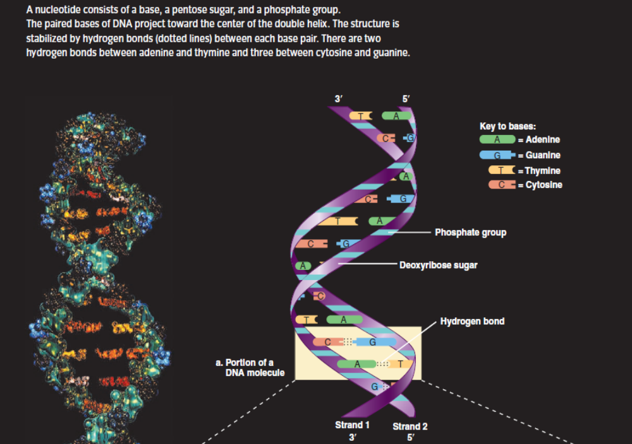
There are two hydrogen bonds between adenine and thymine and three between cytosine and guanine

Slide 23
How DNA Works
1- DNA stores genetic information in segments called genes
2- The DNA code is in Triplet Codons (short sequences of 3 nucleotides each)
3- Certain codons are translated by the cell into certain Amino acids.
4-Thus, the sequence of nucleotides in DNA indicate a sequence of Amino acids in a protein.

Slide 24
RNA Nucleotides
Composition ( 3 parts):
1- Ribose sugar (with O in 3rd carbon)
2- Phosphate group
3- One of 4 types of bases (all containing nitrogen):
- Adenine
- Uracil (only in RNA)
- Cytosine
- Guanine

Slide 25
RNA Nucleotides
RNA is not a storage unit
it may occur inside or outside the nucleus.
RNA serves to regulate cellular metabolism, produce proteins, and govern developmental timing.
RNA is usually a single-stranded molecule.
RNA serves mainly to carry DNA data to protein-making machinery

Slide 26
DNA vs RNA
DNA
1- Deoxyribose sugar
2- Bases: Adenine, Thymine, Cytosine, Guanine
3- Double-stranded helix arrangement
4- DNA is long, containing many genes.
RNA
1- Ribose sugar
2- Bases: Adenine, Uracil, Cytosine, Guanine
3- Single stranded
4- RNA is short: one gene long at most

